Slide 1

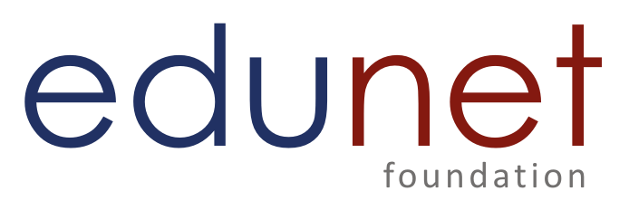
NEXT GEN EMPLOYABILITY PROGRAM
CREATING A FUTURE-READY WORKFORCE
Student Name :
Dhrubanarayan Panda
Student ID :
College Name :
STU6570696e6a64c1701865838
Prabhat Kumar College

Slide 2
CAPSTONE PROJECT SHOWCASE
Project Title
Project Management Tool with React and ExpressJS Framework
Abstract | Problem Statement | Project Overview | Proposed Solution | Technology Used | Modelling & Results | Conclusion | Q&A

Slide 3
Abstract
1
Objective – The Project Management Tool is designed to streamline project planning, execution, and monitoring by addressing inefficiencies and communication gaps in traditional project management.
2
Technology – Built using the MERN stack (MongoDB, ExpressJS, React, and Node.js), the tool leverages modern web technologies to provide a robust, scalable, and user-friendly platform.
3
Key Features – The platform offers task management, team collaboration, progress tracking, deadline management, and real-time updates to enhance productivity and ensure efficient project execution.
4
Impact – By consolidating all project-related activities into a single platform, the tool improves collaboration, enhances efficiency, and helps teams stay organized to achieve timely project delivery.

Slide 4


Problem Statement
Project management often becomes inefficient due to scattered tools, miscommunication, and lack of real-time tracking, leading to delays and reduced productivity. Traditional methods fail to provide centralized access, seamless collaboration, and effective progress monitoring.
The Project Management Tool solves these challenges by offering an all-in-one platform that streamlines planning, execution, and tracking. With intuitive features and real-time updates, it enhances team coordination, boosts efficiency, and ensures timely project delivery.

Slide 5

Project Overview - Project Management System
Built With: MERN Stack (MongoDB, Express.js, React.js, Node.js)
Purpose: Streamlines project planning, execution, and tracking in one unified platform.
Key Features:
Task Management – Create, assign, and track tasks seamlessly. Todo Board – Visual task organization for better workflow. Project Editing – Modify project details in real-time. Collaboration Tools – Enhance teamwork with instant updates. Customizable Settings – Configure server ports, CORS, and database easily.
Setup & Deployment:
Install dependencies → Configure MongoDB → Start backend & frontend
This tool boosts efficiency, enhances collaboration, and ensures smooth project execution.

Slide 6
Proposed Solution
To address the inefficiencies of traditional project management, the Project Management System provides a centralized, user-friendly, and scalable platform built with the MERN stack (MongoDB, Express.js, React.js, Node.js).
Key Solutions:
Unified Platform – Eliminates the need for multiple disconnected tools by consolidating all project-related activities.
Task & Project Management – Enables teams to create, assign, edit, and track tasks efficiently.
Real-Time Collaboration – Ensures seamless communication and updates among team members.
Interactive Todo Board – Provides a visual representation of tasks for better workflow management.
Customizable & Scalable – Allows easy modifications in server settings, database configuration, and frontend adjustments.
This solution enhances team productivity, improves collaboration, and ensures timely project delivery by integrating essential project management functionalities into a single, intuitive platform.

Slide 7
Technology used
The Project Management System is built using the MERN stack along with additional tools and libraries for enhanced functionality.
Frontend:
React.js – Component-based UI for a seamless user experience
Tailwind CSS – Modern styling for responsive and clean design
Headless UI – Accessible and customizable UI components
React Router – Enables dynamic navigation and routing
Axios – Handles API requests efficiently
UUID – Generates unique IDs for tasks and projects
Backend: ⚙️
Node.js – JavaScript runtime for scalable backend operations
Express.js – Lightweight framework for building APIs
MongoDB – NoSQL database for flexible and efficient data storage
Additional Libraries & Tools: 🛠
Joi – Schema validation for input data
CORS – Enables secure cross-origin requests
Dotenv – Manages environment variables securely

Slide 8
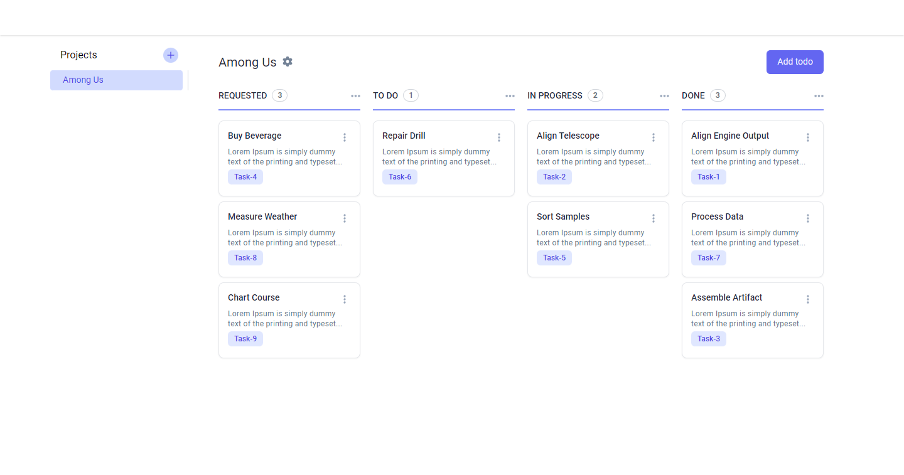
Modelling & Result – TODO Board

Slide 9
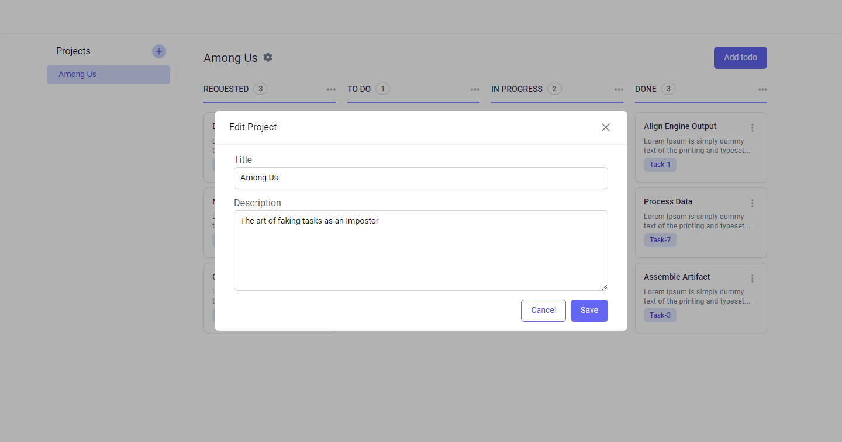
Modelling & Result – Edit Project

Slide 10
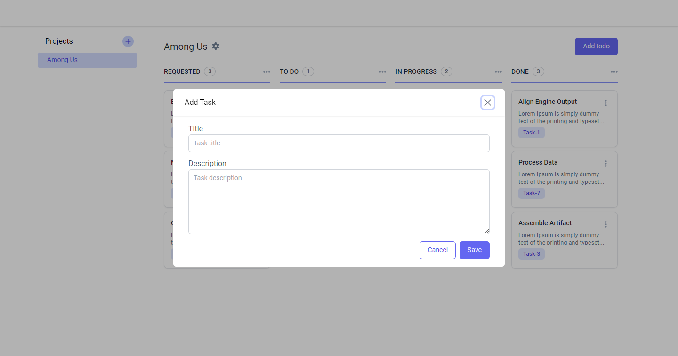
Modelling & Result – Task Insert

Slide 11
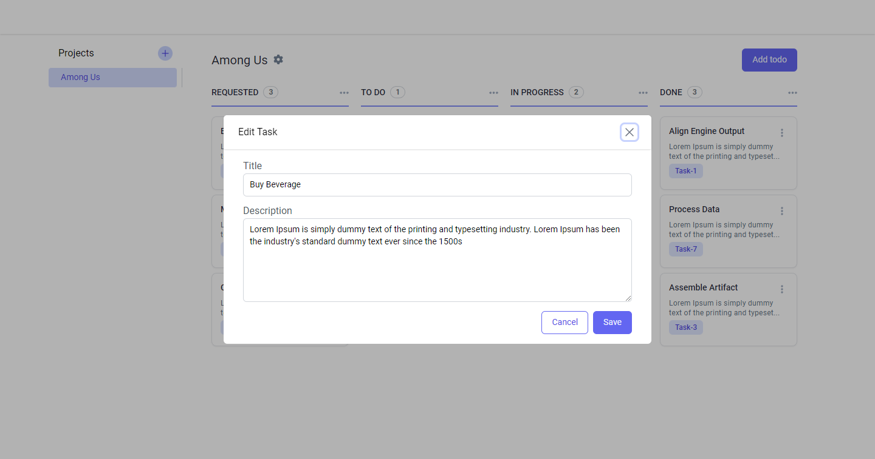
Modelling & Result – Edit Task

Slide 12

Conclusion
The Project Management System built with the MERN stack provides a centralized, efficient, and user-friendly solution for managing projects. By integrating task management, real-time collaboration, and an interactive Todo board, the tool enhances productivity, communication, and workflow organization.
With its scalable architecture and modern web technologies, this system ensures seamless project execution while allowing teams to stay organized and meet deadlines effectively. By eliminating the inefficiencies of using multiple disconnected tools, it empowers teams to work smarter and deliver projects on time.
This project demonstrates the power of full-stack development in creating a practical, scalable, and impactful solution for modern project management.

Slide 13
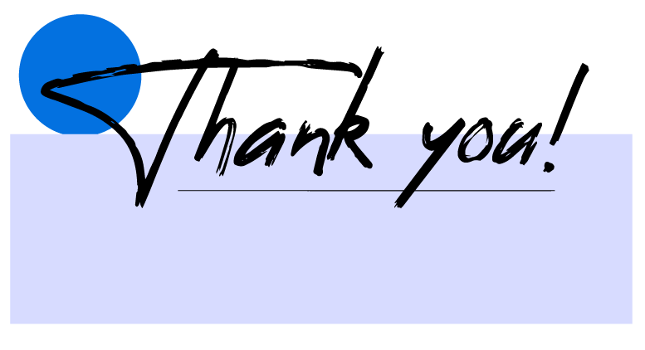
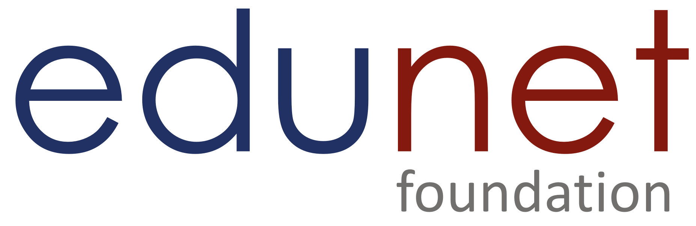
Notes:
Thank You !!

